Slide 1
Applied physics
Lecture 2&3
Presented by: Muhammad Farooq

Slide 2
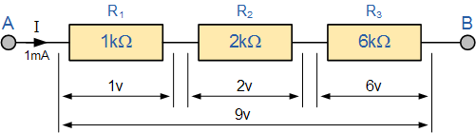
Series and Parallel Resistor Comb.
Resistors are said to be connected in “Series”, when they are daisy chained together in a single line
Resistors in series has common current flowing through them

Slide 3
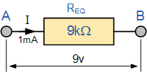

Series and Parallel Resistor Comb. Contd.
The amount of current will remain same throughout the network
$$I_{T}=I_{R1}=I_{R2}=I_{R3}$$
The equivalent resistance is the sum of all the resistance
$$R_{T}=R_{1}+R_{2}+R_{3}$$

Slide 4
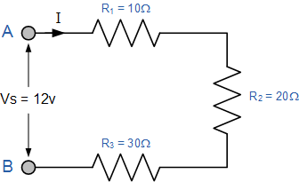
Series and Parallel Resistor Comb. Contd.
A simple example for calculating the total resistance and current

Slide 5
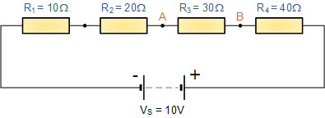
Series and Parallel Resistor Comb. Contd.
Another example for finding the voltage between two points

Slide 6
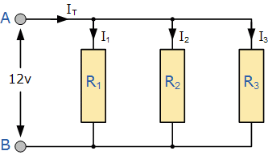
Series and Parallel Resistor Comb. Contd.
In a parallel resistor network the circuit current can take more than one path as there are multiple paths for the current
Resistors in Parallel have a Common Voltage across them but current will divide (depends upon the resistance value)

Slide 7
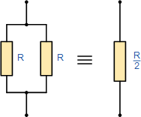
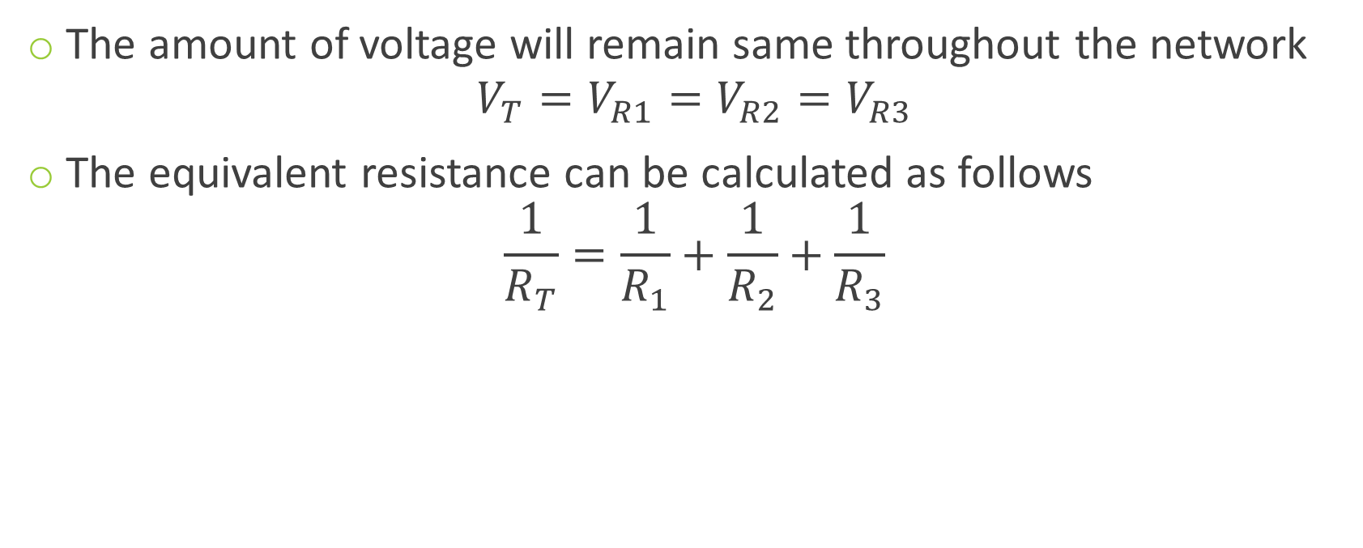
Series and Parallel Resistor Comb. Contd.
The amount of voltage will remain same throughout the network
$$V_{T}=V_{R1}=V_{R2}=V_{R3}$$
The equivalent resistance can be calculated as follows
$$\frac{1}{R_{T}}=\frac{1}{R_{1}}+\frac{1}{R_{2}}+\frac{1}{R_{3}}$$

Slide 8
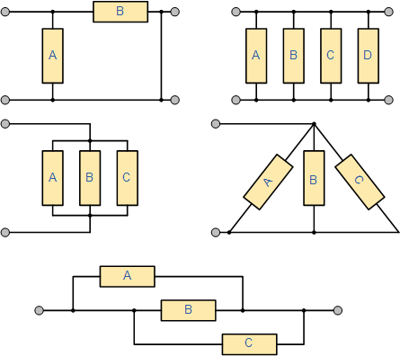
Series and Parallel Resistor Comb. Contd.

Slide 9
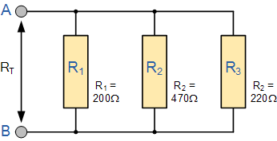
Series and Parallel Resistor Comb. Contd.
An example for parallel network

Slide 10
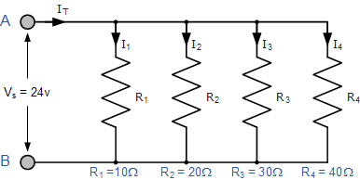
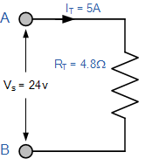
Series and Parallel Resistor Comb. Contd.
Another example

Slide 11
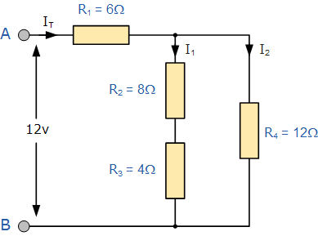
Series and Parallel Resistor Comb. Contd.
A little complex example

Slide 12
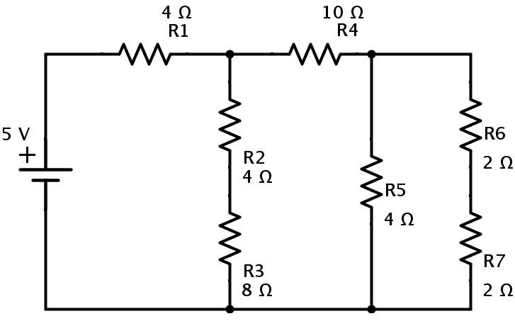
Series and Parallel Resistor Comb. Contd.
Task for you

Slide 13
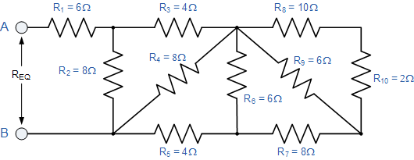
Series and Parallel Resistor Comb. Contd.
A complex example

Slide 14
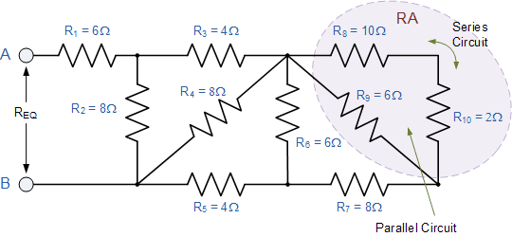
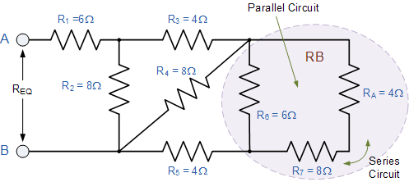
Series and Parallel Resistor Comb. Contd.
A complex example

Slide 15
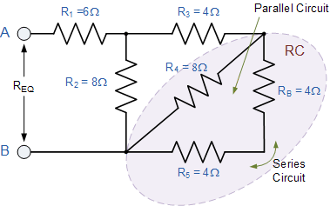
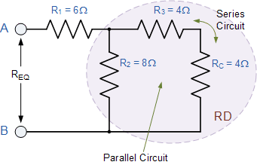
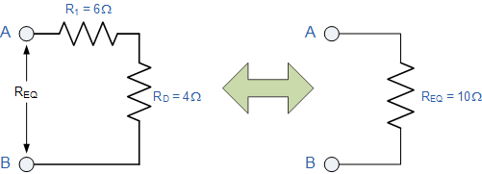
Series and Parallel Resistor Comb. Contd.
A complex example

Slide 16
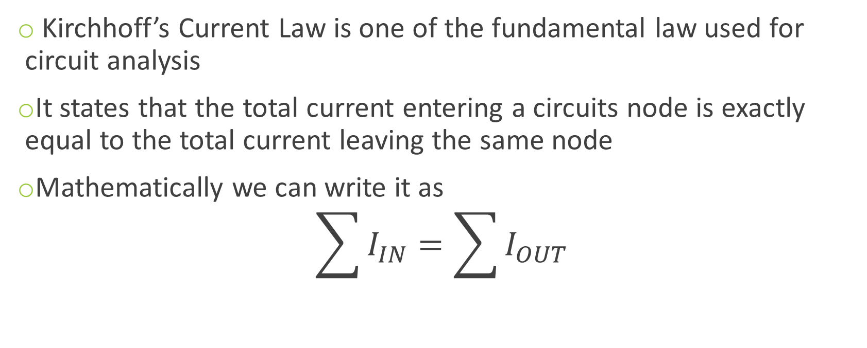
Kirchhoff’s Current Law (KCL)
Kirchhoff’s Current Law is one of the fundamental law used for circuit analysis
It states that the total current entering a circuits node is exactly equal to the total current leaving the same node
Mathematically we can write it as
$$\sum{I_{IN}=\sum{I_{OUT}}}$$

Slide 17
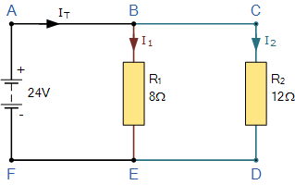
Kirchhoff’s Current Law (KCL) contd.
lets take a simple example

Slide 18
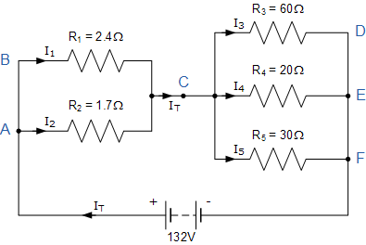
Kirchhoff’s Current Law (KCL) contd.
lets take a complex example

Slide 19
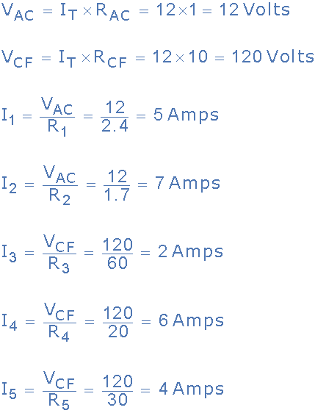
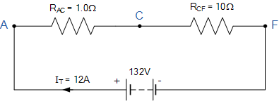
Kirchhoff’s Current Law (KCL) contd.
Equivalent circuit will be

Slide 20
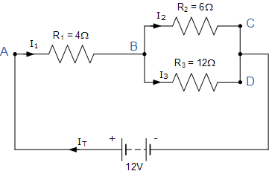
Kirchhoff’s Current Law (KCL) contd.
Lets take another simple example

Slide 21
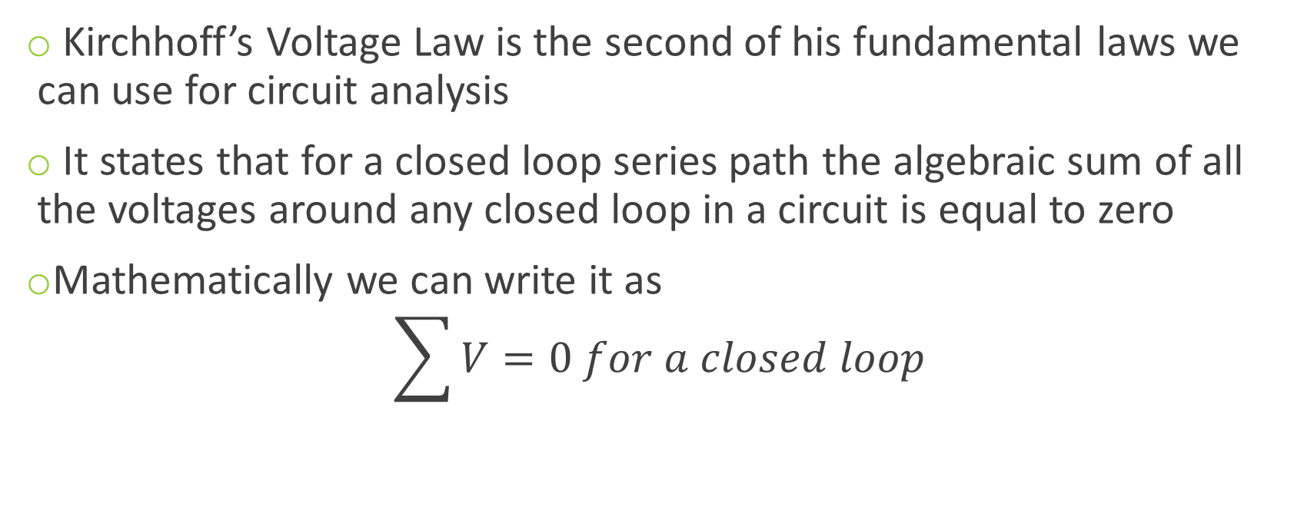
Kirchhoff’s Voltage Law (KVL)
Kirchhoff’s Voltage Law is the second of his fundamental laws we can use for circuit analysis
It states that for a closed loop series path the algebraic sum of all the voltages around any closed loop in a circuit is equal to zero
Mathematically we can write it as
$$\sum{V}=0 for a closed loop$$

Slide 22
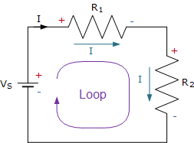
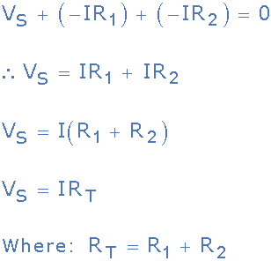
Kirchhoff’s Voltage Law (KVL) contd.

Slide 23
Kirchhoff’s Voltage Law (KVL) contd.
Three resistor of values: 10 ohms, 20 ohms and 30 ohms, respectively are connected in series across a 12 volt battery supply. Calculate: a) the total resistance, b) the circuit current, c) the current through each resistor, d) the voltage drop across each resistor e) verify that Kirchhoff’s voltage law, KVL holds true.

Slide 24
Series and Parallel Resistor Comb.
Resistors are said to be connected in “Series”, when they are daisy chained together in a single line
Resistors in series has common current flowing through them

Slide 25
Series and Parallel Resistor Comb. Contd.
The amount of current will remain same throughout the network
$$I_{T}=I_{R1}=I_{R2}=I_{R3}$$
The equivalent resistance is the sum of all the resistance
$$R_{T}=R_{1}+R_{2}+R_{3}$$

Slide 26
Series and Parallel Resistor Comb. Contd.
A simple example for calculating the total resistance and current

Slide 27
Series and Parallel Resistor Comb. Contd.
Another example for finding the voltage between two points

Slide 28
Series and Parallel Resistor Comb. Contd.
In a parallel resistor network the circuit current can take more than one path as there are multiple paths for the current
Resistors in Parallel have a Common Voltage across them but current will divide (depends upon the resistance value)

Slide 29
Series and Parallel Resistor Comb. Contd.
The amount of voltage will remain same throughout the network
$$V_{T}=V_{R1}=V_{R2}=V_{R3}$$
The equivalent resistance can be calculated as follows
$$\frac{1}{R_{T}}=\frac{1}{R_{1}}+\frac{1}{R_{2}}+\frac{1}{R_{3}}$$

Slide 30
Series and Parallel Resistor Comb. Contd.

Slide 31
Series and Parallel Resistor Comb. Contd.
An example for parallel network

Slide 32
Series and Parallel Resistor Comb. Contd.
Another example

Slide 33
Series and Parallel Resistor Comb. Contd.
A little complex example

Slide 34
Series and Parallel Resistor Comb. Contd.
Task for you

Slide 35
Series and Parallel Resistor Comb. Contd.
A complex example

Slide 36
Series and Parallel Resistor Comb. Contd.
A complex example

Slide 37
Series and Parallel Resistor Comb. Contd.
A complex example

Slide 38
Kirchhoff’s Current Law (KCL)
Kirchhoff’s Current Law is one of the fundamental law used for circuit analysis
It states that the total current entering a circuits node is exactly equal to the total current leaving the same node
Mathematically we can write it as
$$\sum{I_{IN}=\sum{I_{OUT}}}$$

Slide 39
Kirchhoff’s Current Law (KCL) contd.
lets take a simple example

Slide 40
Kirchhoff’s Current Law (KCL) contd.
lets take a complex example

Slide 41
Kirchhoff’s Current Law (KCL) contd.
Equivalent circuit will be

Slide 42
Kirchhoff’s Current Law (KCL) contd.
Lets take another simple example

Slide 43
Kirchhoff’s Voltage Law (KVL)
Kirchhoff’s Voltage Law is the second of his fundamental laws we can use for circuit analysis
It states that for a closed loop series path the algebraic sum of all the voltages around any closed loop in a circuit is equal to zero
Mathematically we can write it as
$$\sum{V}=0 for a closed loop$$

Slide 44
Kirchhoff’s Voltage Law (KVL) contd.

Slide 45
Kirchhoff’s Voltage Law (KVL) contd.
Three resistor of values: 10 ohms, 20 ohms and 30 ohms, respectively are connected in series across a 12 volt battery supply. Calculate: a) the total resistance, b) the circuit current, c) the current through each resistor, d) the voltage drop across each resistor e) verify that Kirchhoff’s voltage law, KVL holds true.

